Slide 1
SWE2315 : System ANALYSIS & DESIGN
Lecture 01: Introduction
At: CIT Theater
By: 2-4pm

Slide 2
Course Objectives
To teach students new ways of looking at information in order to solve business problems.
To teach students effective methods for gathering and documenting essential information during system analysis.
To teach students effective methods for analysing and designing systems to solve problems effectively using appropriate methodology and technology

Slide 3
Course Structure
Two Parts
System Analysis (The “what”)
System Design (The “how”)

Slide 4
Assessment
CA – 30%
Exams – 70%

Slide 5
Essential Texts
System Analysis and design,
by Dennis, Wixom and Roth
System Analysis and design in a changing world,
by Satzinger, Jackson and Burd
System Analysis and design with UML, version 2.0
by Dennis, Wixom and Tegarden

Slide 6
Why systems?
Computerized systems are becoming our way of life.
Important issue to understand and build computer systems as they are everywhere in our lives (home, office, body)
Systems can be quite large complicated so they may require a team to develop, a model to be followed and some certain skills and capabilities.

Slide 7
What is a System?
The term system is coined from the Greek word syst_ema, meaning to “place together”
A System is an integrated set of interoperable units. Each unit has a specified and bounded functions. All the units work together to perform a value-added processing, in a prescribed operating environment, with a specified outcome and probability of success. This enables user to satisfy a mission-oriented operational needs

Slide 8


Different Types of Systems
Management information system (MIS)
Transaction processing system (TPS)
Office automation system
Decision support system (DSS)
Expert system

Slide 9
Basic Representation of a System
Process
Input
Output

Slide 10
System Components
Resources : hardware or software
Procedure: Set of rules
Data/information: Input and output
Process: the operational element of the system that makes use of the resources to operate on the data under the defined procedures in order to achieve the desired goal.

Slide 11
SDLC
The systems development life cycle (SDLC) is the process of determining how an information system (IS) can support business needs, designing the system, building it, and delivering it to users.
The key person in the SDLC is the systems analyst,
A System Analyst analyses the business situation, identifies the opportunities for improvements, and designs an IS to implement the improvements.
Notes:
Consultant, Support Expert and Agent of change

Slide 12
Systems Analyst
The systems analyst works closely with all project team members so that the team develops the right system in an effective way.
Systems analysts must understand how to apply technology in order to solve problems.
Systems analysts may serve as change agents who identify organizational improvement needed, design systems to implement those changes, train and motivate others to use the systems.
Notes:
Consultant, Support Expert and Agent of change

Slide 13
System Analysts Skills
Technical–Must understand the technical environment, technical foundation, and technical solution.
Business–Must understand how IT can be applied to business situations.
Analytical–Must be problem solvers.
Interpersonal–Need to communicate effectively.
Management–Need to manage people and to manage processes and risks.
Ethical-Must deal fairly, honestly, and ethically with other project members, managers, and systems users.
Notes:
Consultant, Support Expert and Agent of change

Slide 14
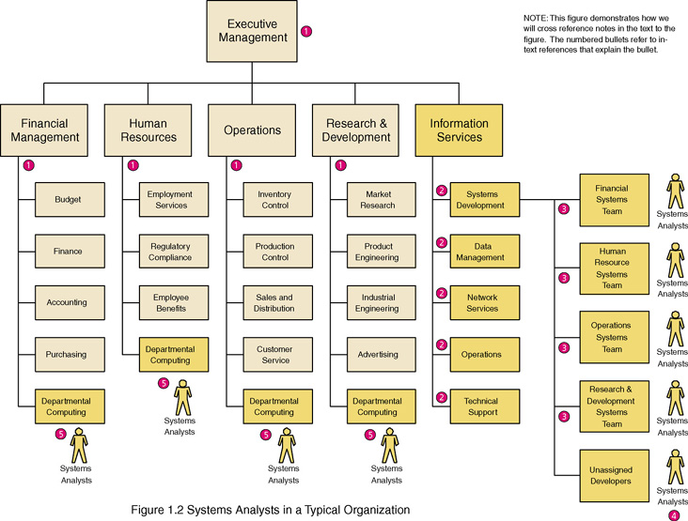
Where Do Systems Analysts Work?

Slide 15
SDLC
The first three (3) stages will be the focus in this course
Notes:
Consultant, Support Expert and Agent of change

Slide 16
Planning, Analysis & Design
Planning: This phase is the fundamental process of understanding why an information system should be built, and determining how the project team will go about building it.
Analysis: The analysis phase answers the questions of who will use the system, what the system will do, and where and when it will be used. During this phase the project team investigates any current system(s), identifies improvement opportunities, and develops a concept for the new system.
Design: The design phase decides how the system will operate, in terms of the hardware, software, and network infrastructure; the user interface, forms, and reports that will be used; and the specific programs, databases, and files that will be needed.
Notes:
Consultant, Support Expert and Agent of change

Slide 17
Project Planning
Project Initiation
Project Management

Slide 18
Project Initiation
Identification is Done by Project Sponsor
System Request is then written after identification
Feasibility is conducted on the System Request

Slide 19
Project Identification
A project is identified when someone in the organization identifies a business need to build a system.
Examples of business needs include supporting a new marketing campaign, reaching out to a new type of customer, or improving interactions with suppliers.
Business needs arise may arise from some kind of pain within the organization.
Example drop in market share, poor customer service levels, unacceptable product defect rates, or increased competition.

Slide 20
Project Identification
Business need may be due to new business initiatives and strategies created and a system to support them is required.
Business needs also can surface when the organization identifies unique and competitive ways of using IT.
For example, if companies stay abreast o technological advances such as cloud computing
Notes:
Ideally, companies can take advantage of this first mover position by making money and continuing to innovate while competitors trail behind.

Slide 21
Project Identification
When a strong business need for an information system is recognized, as a result of a person or group of people who have an interest in the system’s success (project sponsor)
The next step is to determine high-level business requirements for the systems.
Business requirements describe the reasons for developing the system and outline the benefits it will provide the organization.
business requirements are explained at a high level for approval and for project team understand what the business expects from the final product.

Slide 22
Project Identification
Once a project sponsor identifies a project that meets an important business need and he or she can identify the business requirements and business value of the system, it is time to formally initiate the project.
Usually, the sponsor of the project is from a business function such as marketing, accounting, or finance; however, members of the IT area also can sponsor or cosponsor a project.
In most organizations, project initiation begins by preparing a system request.
Notes:
The size or scope of the project often determines the kind of sponsor who is
involved.

Slide 23
System Request
A system request is a document that describes the business reasons for building a system and the value that the system is expected to provide.
The project sponsor usually completes this form as part of a formal system project selection process within the organization.
Most system requests include five elements: project sponsor, business need, business requirements, business value, and special issues.

Slide 24
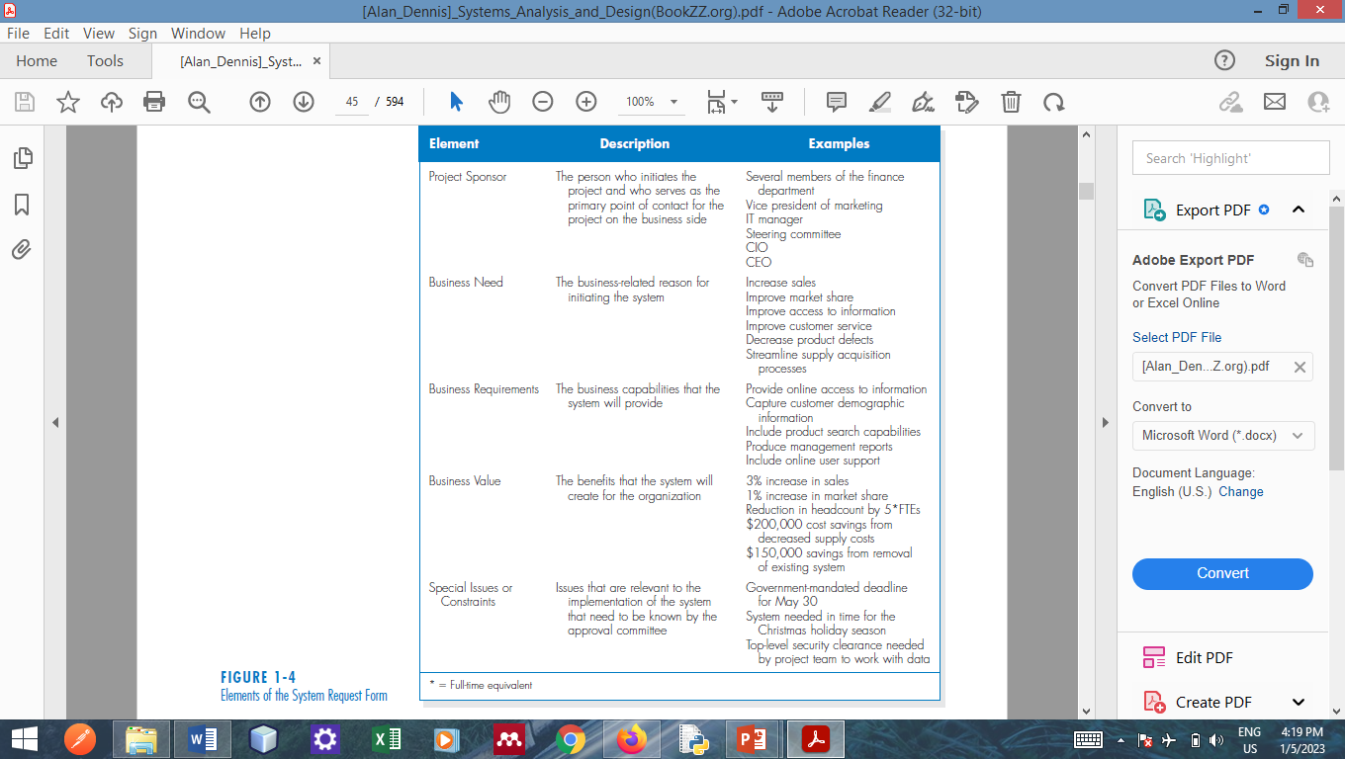
System Request-- Elements

Slide 25
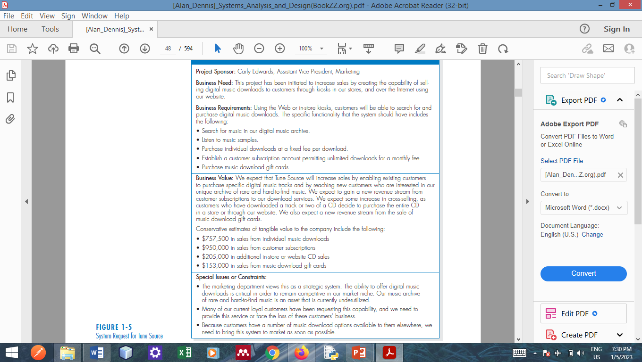
System Request--Example

Slide 26
System Request--Decision
The approval committee reviews the system request and makes an initial determination, based on the information provided, of whether to investigate the proposed project or not.
If so, the next step is to conduct a feasibility analysis.

Slide 27
Feasibility Analysis
Once the need for the system and its business requirements have been defined, the approval committee may authorize the systems analyst to prepare a more detailed business case to better understand the proposed information system project.
Feasibility analysis guides the organization in determining whether to proceed with the project.

Slide 28
Feasibility Analysis
Feasibility analysis also identifies the important risks associated with the project that must be managed if the project is approved.
Most feasibility analysis include techniques to assess three areas:
technical feasibility,
economic feasibility,
and organizational feasibility

Slide 29
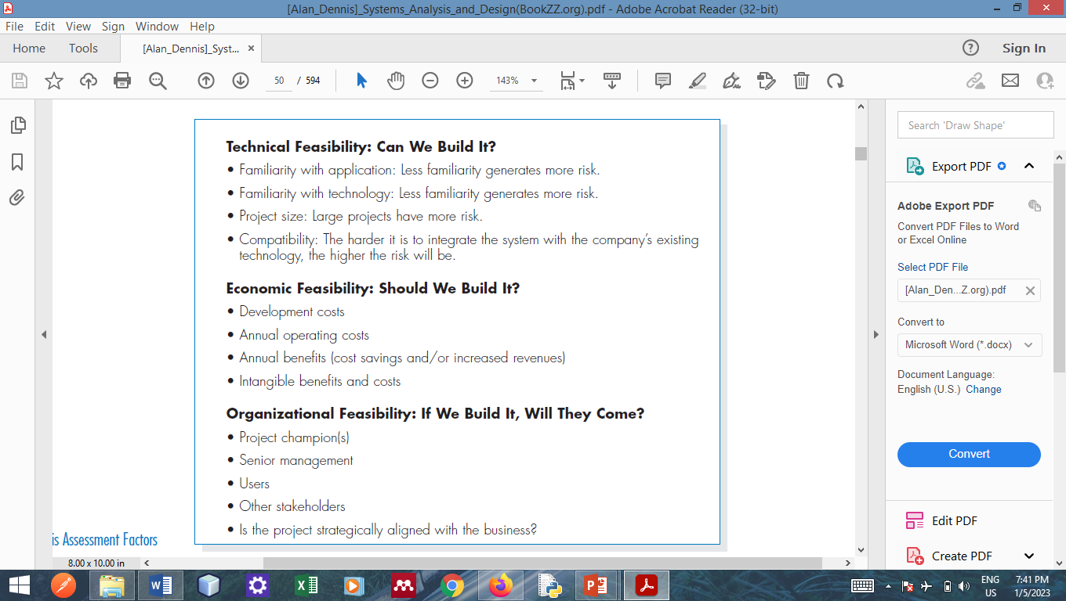
Feasibility Assessment Factors

Slide 30
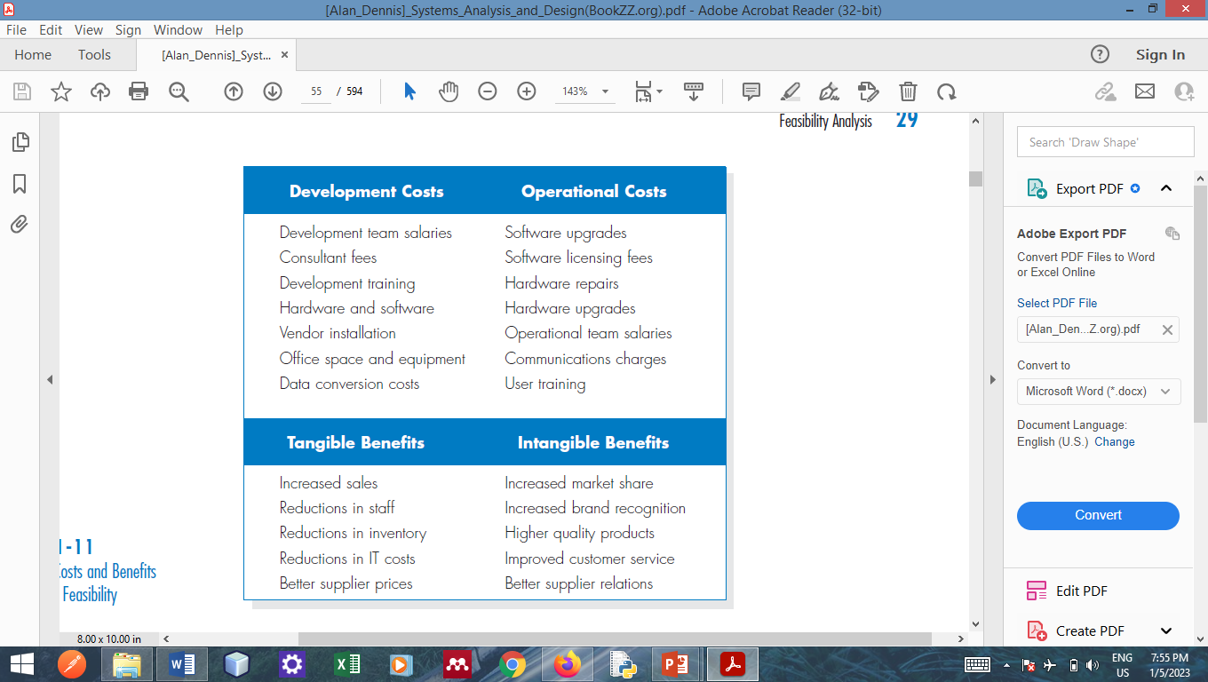
Economic Feasibility

Slide 31
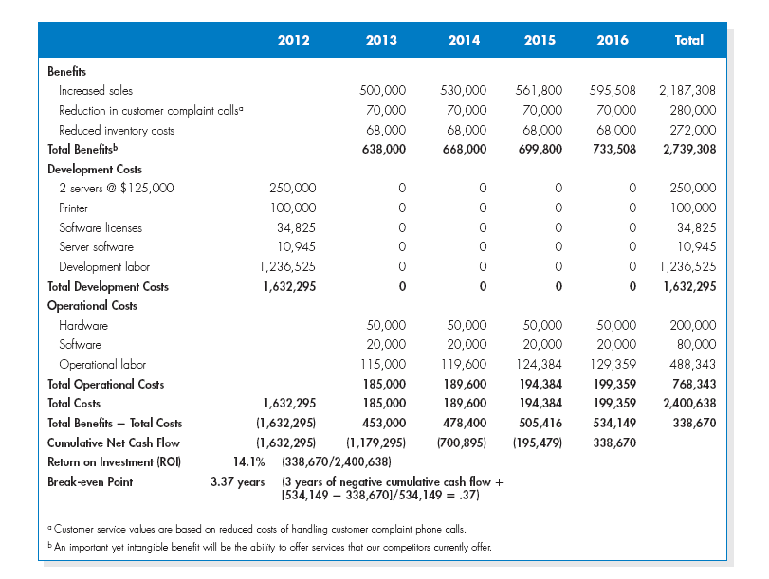
Economic Feasibility
Cash Flow = Benefit – Cost
Return on Investment (ROI) = (Cummulative Net Cashflow)/Total Costs

Slide 32
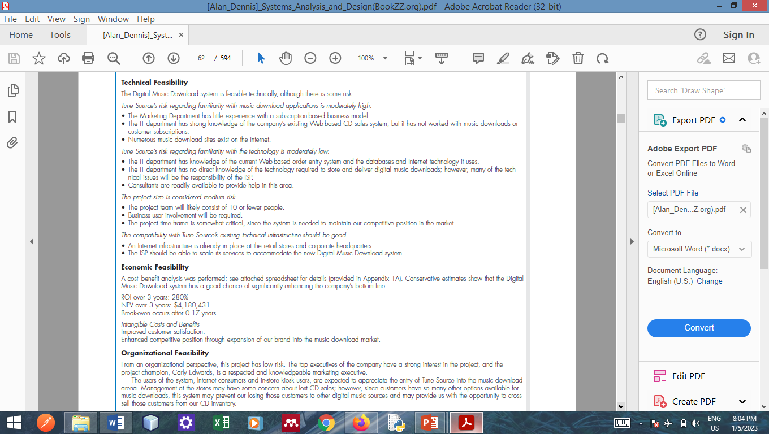
Feasibility Report Example

Slide 33
Feasibility-Critical Decision
The feasibility report should guide the entire organization to decide whether or not the proposed system is the best solution and is feasible.
If it is, then project development move to the planning phase, otherwise it is terminated.

Slide 34
Questions !!!

